Slide 1
CS 499 mid-term project
group member: Yijun Gan, Yuwen Hu, Ji Cui, Ruiheng Ma

Slide 2
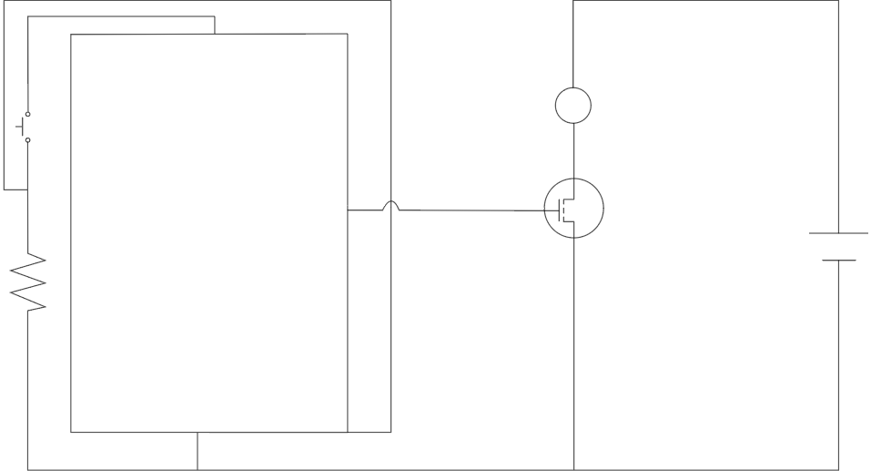
Circuit Diagram
5 V
motor
+
10KΩ
-
GND

Slide 3
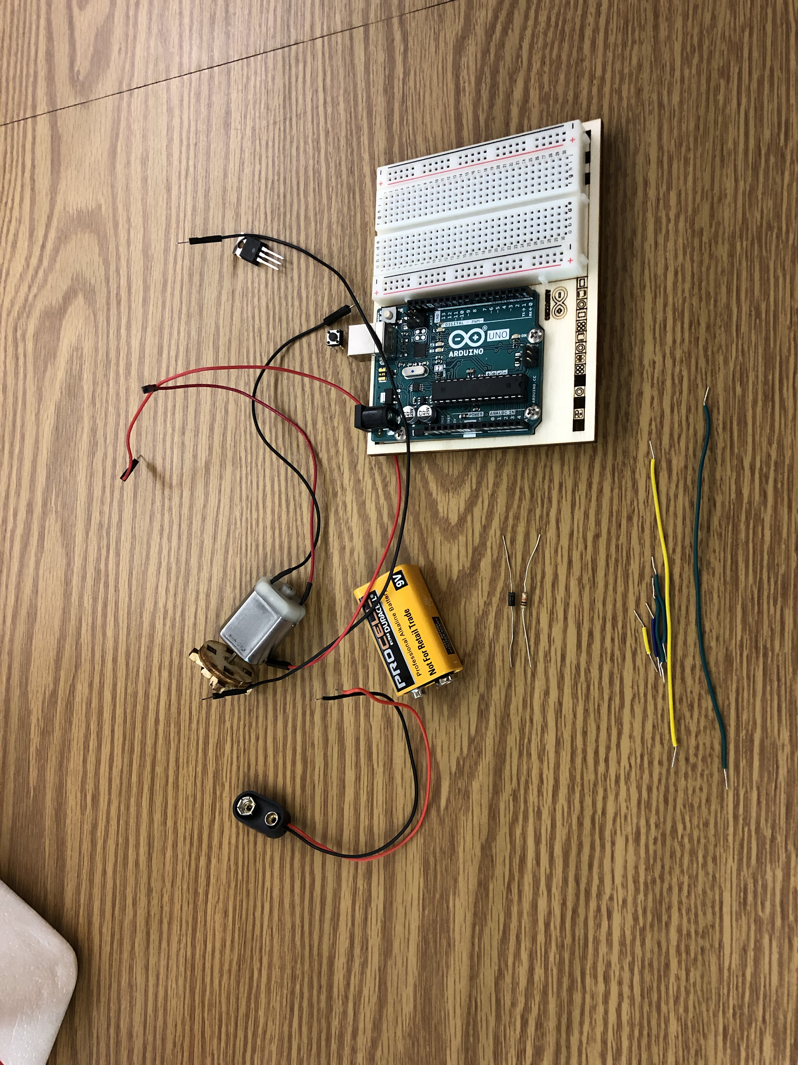
Components
9 V battery, wires, resistance, MOSFET, diode, motor, bread borad and Arduino board.

Slide 4
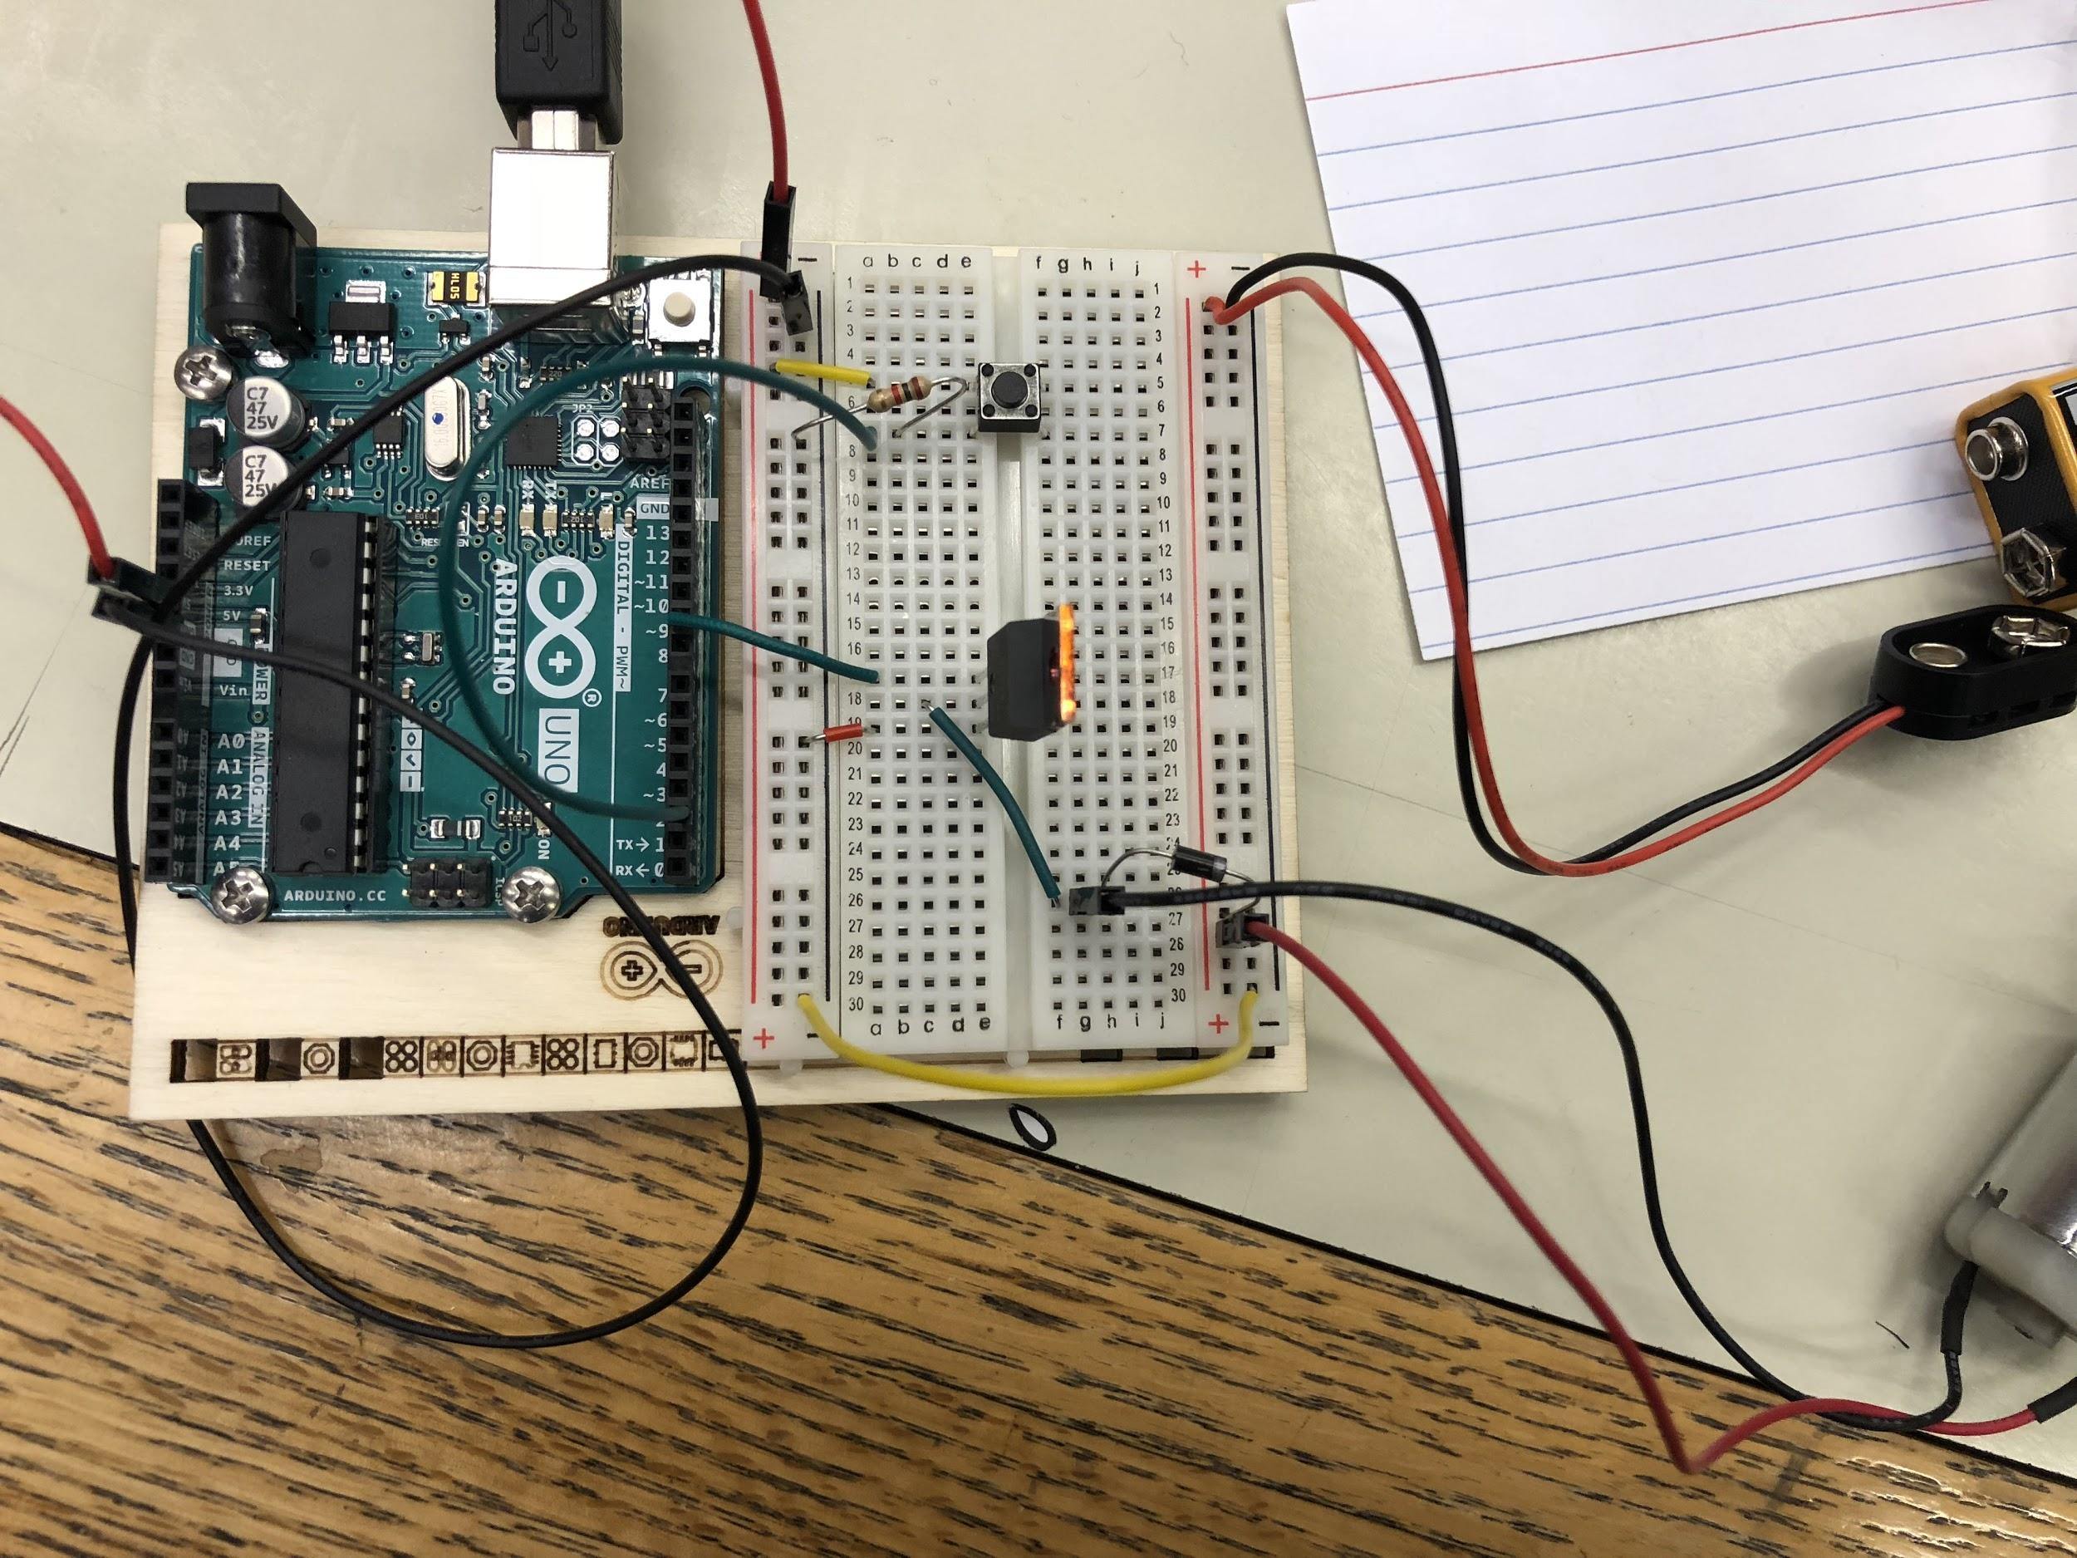
How to Connect
Connect to the power and ground to the breadboard.

Slide 5
Add a switch to the breadboard, and connecting the power and the other side.

Slide 6
Add a 10-kilohm resistor to the ground.

Slide 7
Connect the battery(9V).

Slide 8
Transistors are components that allow us to control high current and high voltage from the low current output of microcontrollers, especially Arduino.

Slide 9
Transistor:
A transistor has 3 pins:
Gate: connect digital pin 9 to the left pin on the transister.
Drain: connect the motor to the middle pin of the transistor.
Source: when the transistor is activated, this pin will be connected to the third pin. It will connect the source to the ground.

Slide 10
The diode can only allow the electric current go one way. It means it can rectifying the electric current.

Slide 11
The cathode of the motor connect with the middle side of the MOSFET. The anode of the motor connect with the anode of the breadboard by the green line, which parallel connect with the diode.

Slide 12
The motorpin 9 connect with the trasister, so it can control the motor.

Slide 13
Connect two side’s cathode.

Slide 14
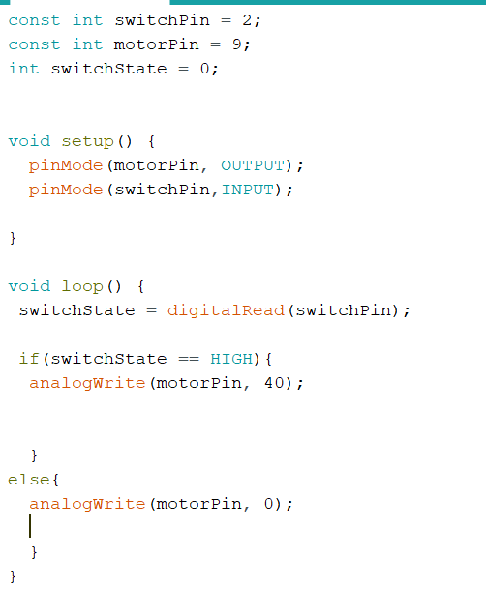
Code
set the value of switchstatement
The void keyword is only used for function declarations. It means that the function is expected not to return any information to the function that called it.
Declar the pin’s direction.
switch is pressed, turn the motoPin 40. If not , turn the pin 0. when 40, the motor circuit. when 0, the circuit not spin.

Slide 15
Demo

